Slide 1

Dissertation Report
Analysis and design of soccer robot
NAME: PHAN TIEN MINH ( ID : 1852581 )
BUI VIET THANG
INSTRUCTOR: Dr. PHAM CONG BANG
1 min

Slide 2

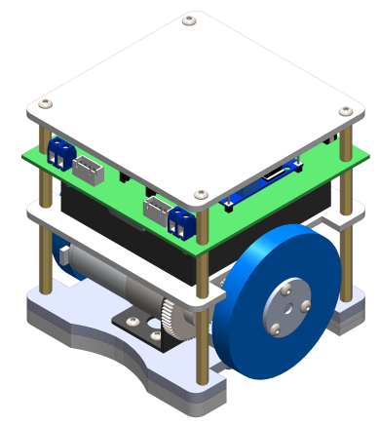
Agenda
HCMUT - ME
Nr. | Topic | Time
1 | INTRODUCTION
2 | DESGIN SELECTION
3 | MECHANICAL DESIGN
4 | ELECTRICAL DESIGN
5 | KINEMATIC MODEL AND CONTROL SYSTEM OF THE ROBOT
6 | VISION SYSTEM
7 | PATH PLANNING ALGORITHM
8 | CONCLUSION AND RECOMMENDATION
1 min

Slide 3
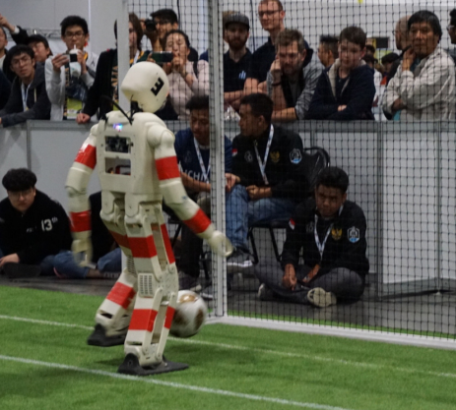
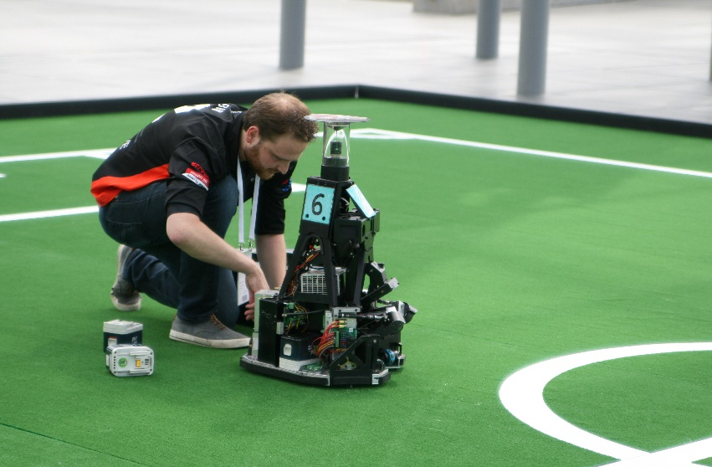
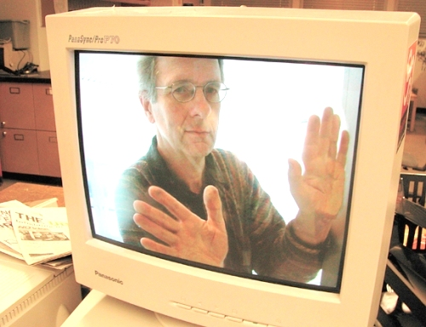
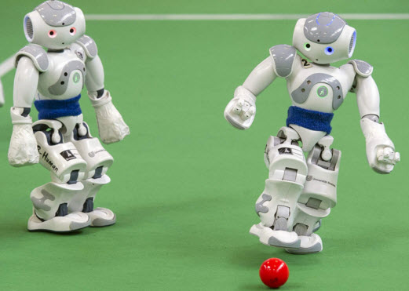
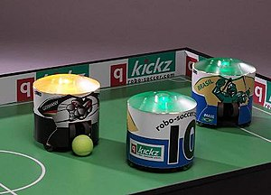


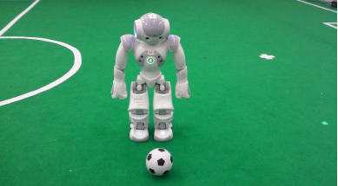
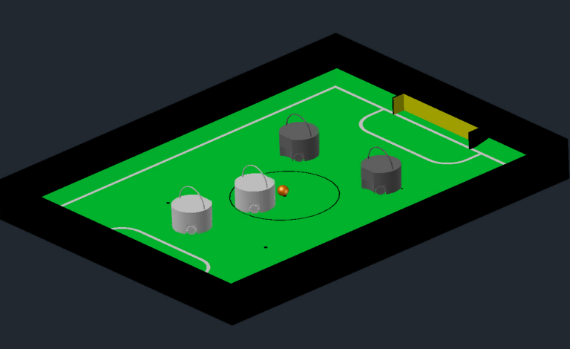
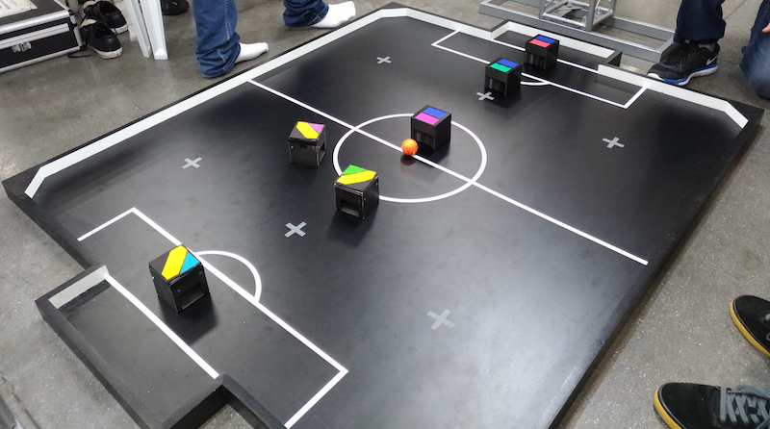
1. INTRODUCTION
HCMUT - ME
1.1 Abstract
Definition
History
Competitions
Leagues
Team NimbRo, winner of the Best Humanoid Award 2019
RoboCup MSL Leipzig, Germany (2016)
IEEE Very Small Size RoboCup Soccer in the Latin American and Brazilian Robotics Competition
Alan Mackworth
A soccer robot is a one kind of mobile or autonomous robot, used to play soccer with variants
NAO and official ball
Two teams of two robots with an orange ball on a RoboCupJunior Soccer field
3 mins
Notes:
A soccer robot is a one kind of mobile or autonomous robot, used to play soccer with variants
The idea of robot soccer games started in 1997 by Alan Mackworth, which has evolved into international robotics competitions.
The main organised competitions are RoboCup or FIRA tournaments played each year.

Slide 4
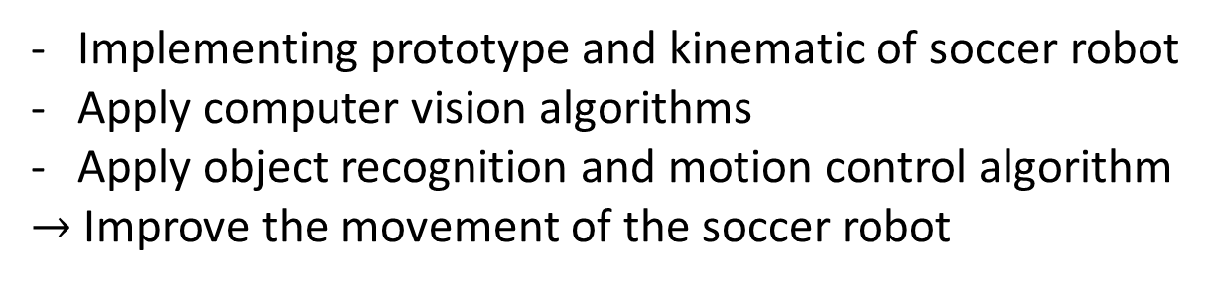
1. INTRODUCTION
HCMUT - ME
1.2 Objective
Implementing prototype and kinematic of soccer robot
Apply computer vision algorithms
Apply object recognition and motion control algorithm
$→$ Improve the movement of the soccer robot

Slide 5
1. INTRODUCTION
HCMUT - ME
1.3 Scope
Design differential wheeled soccer robot
The robot prototype is differential wheel robot with 2 main motor and 1 free turning wheel
A colored golf ball shall be used as a ball, with standard weight and diameter
The robot can shoot the static ball into goal

Slide 6
1. INTRODUCTION
HCMUT - ME
1.4 Thesis’s chapter
Chapter 2: Design mechanical part of the soccer robot
Chapter 3: Design electrical circuit for the robot
Chapter 4: Implement the computer vision of the soccer robot system
Chapter 5: Design the motion control of the robot to shoot a ball into a goal
Chapter 6: Evaluate the project.

Slide 7
HCMUT - ME
THANK YOU FOR YOUR ATTENTION

Slide 8
2. PRINCIPLE & SELECTION
2.1 Mechanical principles selection
HCMUT - ME
2.1.1 Affecting factor
Small size robot
Easy for installing elements
Desired velocity
The robot should be balanced
Robot parameters
Base size
Number of wheel
Wheel radius

Slide 9
2. PRINCIPLE & SELECTION
2.1 Mechanical principles selection
HCMUT - ME
2.1.2 Specifications
Technical requirement:
Size: a cube 100x100x100 mm
Mass: 1kg
Maximum speed: 1 m/s

Slide 10
2. PRINCIPLE & SELECTION
2.1 Mechanical principles selection
HCMUT - ME
2.1.3 Mechanisms

Slide 11
2. PRINCIPLE & SELECTION
2.1 Mechanical principles selection
HCMUT - ME
2.1.3 Mechanisms
Chosen mechanism
Schematic diagram

Slide 12
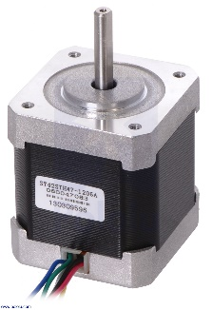
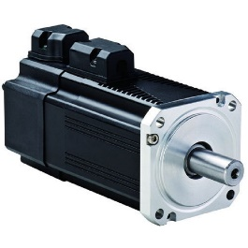
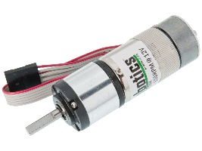
2. PRINCIPLE & SELECTION
2.2 Motor selection
HCMUT - ME

Slide 13
2. PRINCIPLE & SELECTION
2.2 Motor selection
HCMUT - ME

Slide 14
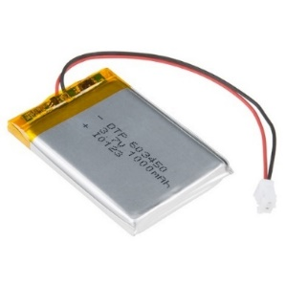
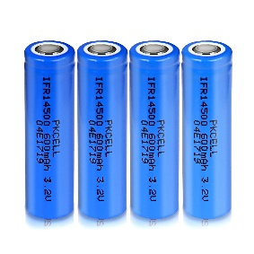
2. PRINCIPLE & SELECTION
2.2 Battery selection
HCMUT - ME

Slide 15
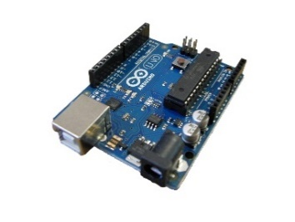
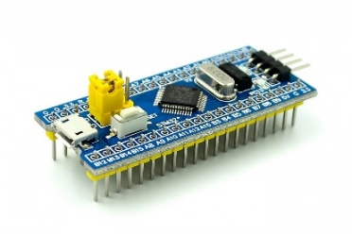
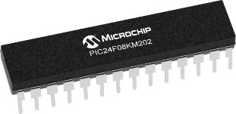
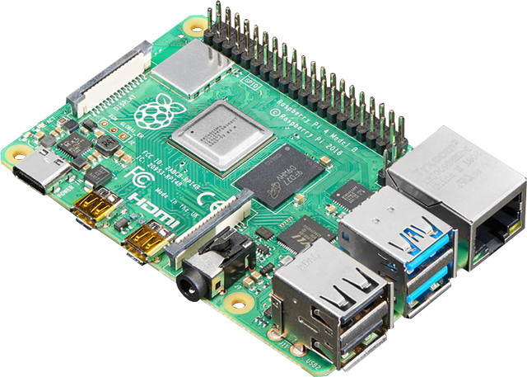
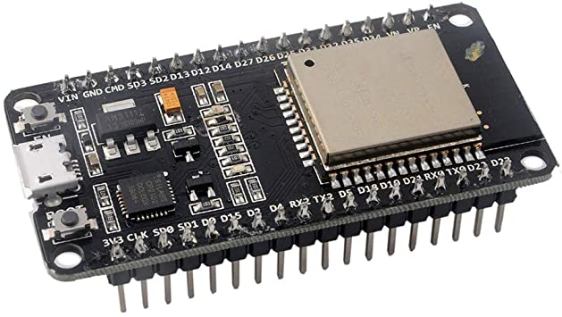
2. PRINCIPLE & SELECTION
2.2 Controller selection
HCMUT - ME

Slide 16
2. PRINCIPLE & SELECTION
2.2 Control mechanism
HCMUT - ME

Slide 17
3. Mechanical Design
2.2 Control mechanism
HCMUT - ME

